Slide 1
Climate change and everyday mobility – social impacts, adaption and mitigation strategies
NFR Research Project. KLIMAFORSK.
Dr. Tanu Priya Uteng and Dr. Maja Karoline Rynning
Norsk Planmøte 2018

Slide 2
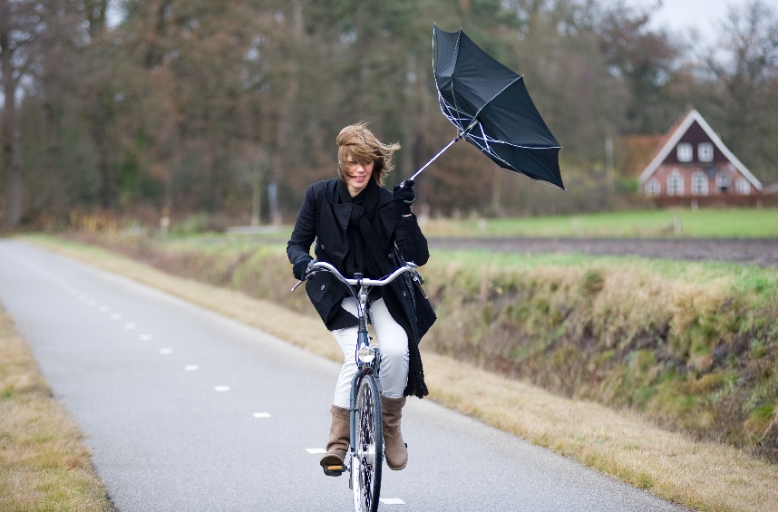
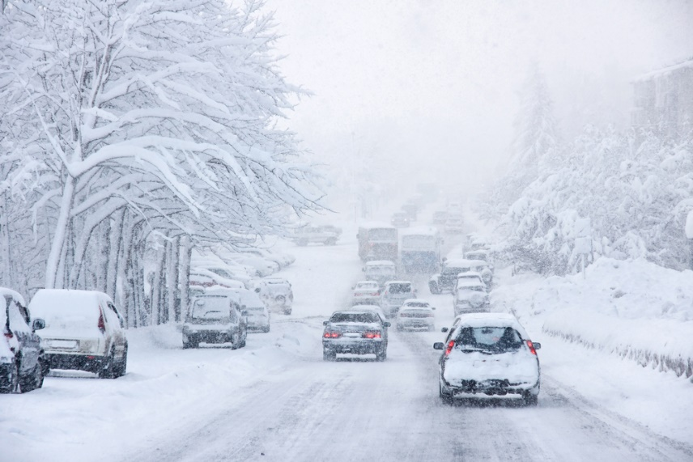
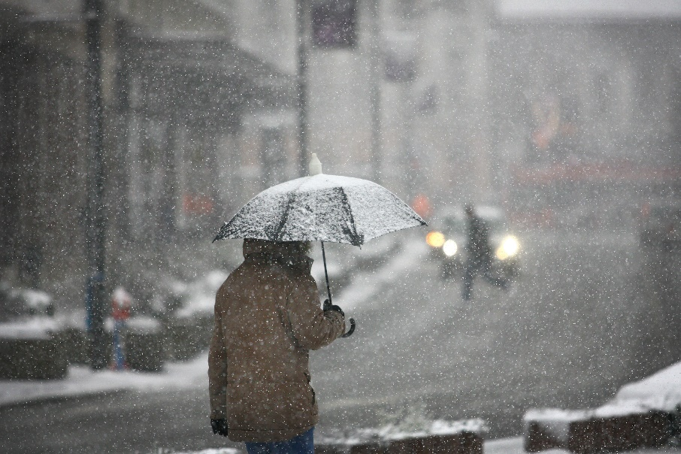
The Personal:
DRIVE
PUBLIC TRANSPORT
WALK
CYCLE
DREAM /
STAY HOME
VIRTUAL MOBILITY
WHY?HOW?
The Institutional:
PLAN FOR?
IGNORE?
ANTICIPATED CHANGES?

Slide 3
The Project Team
Randi Hjørthol (retired)
Tanu Priya Uteng
Lars Böcker
Susanne T. Dale Nordbakke
Maja Karoline Rynning
along with MET

Slide 4
WP1
What does our travel surveys reveal?
Purpose: To gain knowledge on how weather conditions relate to how we move.

Slide 5
The Model

Slide 6
Main finding
Sky darkness (even when controlled for night-time hours) has negative effects on trip chaining and the use of active transport modes
Low air temperatures, rainfall and wind speed = reduced cycling
Adverse weather conditions stimulate the combining of trips into more efficient trip chains
Non-linear (bell-shaped) air temperature effects on bicycle usage and outdoor leisure activities = possible negative effects of heat.
Geographical context with regard to transport and land use, climate conditions, cultures, habits and adaptations.
Effects of weather on transport mode choices are much stronger in Utrecht than in Stavanger, even though both cities share a somewhat comparable maritime climate. A likely explanation is related to the transport regime.
Potential role of habit and adaptation. Ex. Adapting to snow conditions.
Climate, land use and cultural context. Ex. visiting of outdoor leisure destinations relative to work trips.

Slide 7
WP2
Who are the most tolerant in terms of travel behaviour to weather conditions?
Purpose: To gain knowledge on what characterizes those who are most likely to defy poor weather conditions and use active transport or public transport instead of a car.

Slide 8
Data
A representative questionnaire survey in Oslo and Stavanger in 2015 (november)
Internet panel
Response rate: 57,3 percent
This study is limited to those who are either working or attending school: N=1663 (Oslo N= 855; Stavanger N=808)
Data is weighted by gender, age and education according to public statistics from Statistics Norway
City | N
Oslo | 1060
Stavanger | 1037
Total | 2097

Slide 9
Main finding
Environmental attitudes and (daily) travel habits are associated with weather tolerance
Attitudes and habits are important for how people react to changes in weather conditions, when other factors such as age, gender, education and city/residential location are controlled for.

Slide 10
WP3
What are the projected changes in climate elements relevant to everyday travel behaviour up to 2050?
Purpose: To gain knowledge on how weather conditions will be in 2050.

Slide 11
Hot days are defined as days with maximum temperature higher than 25 °C. In present climate, the Oslo area has an average of 15 hot days per year, and Stavanger 4 d/year. The projections indicate that in “2050”, Oslo will have 12 more hot days/year than in present climate; Stavanger 3-4 more hot days.
Very hot days are defined as days with maximum temperature higher than 30 °C. In present climate, Oslo has in average 1.0 very hot days per year; Stavanger 0.3 days/yr. This means that in Stavanger very hot days occur in average just every third year. The projections indicate a rather modest increase: +0.5 “very hot days”/year for Stavanger and +2 days/year for the Oslo area. Consequently, “very hot days” will occur rather seldom also in “2050”; - in average 3 d/year in Oslo and 1 d/year in Stavanger.
Number of wet days is defined as days with more than 5 mm precipitation. In present climate, the Oslo area has in average ca. 55 wet days per year, and Stavanger ca. 85 days/year. The projections indicate rather small changes up to “2050”; - i.e. an increase of less than 5 wet days per year both in Oslo and Stavanger.
Stavanger is more exposed for high wind speeds than Oslo. Wind speed in Stavanger is exceeding 5 m/s (12 km/h, “Gentle breeze”) for more than 30% of the time both during summer and also on an annual basis. In Oslo this wind force is exceed just in 10 % of the time in present climate. Climate models indicate small or no changes in wind conditions up to the end of this century, but the uncertainty is large.
In Stavanger, rainy days tend to be windier than dry days. In Oslo there is no difference in mean wind speed for wet and dry days during the summer season.
Snow on ground is observed for 114 days/year at Oslo-Blindern in present climate, and 37 days per year in Stavanger. The projections indicate substantial reductions in length of snow season: In lower parts of the Oslo area the number of days with snow on the ground will be almost half of the present level, while in Stavanger days with snow on the ground will be very rare.

Slide 12
WP3
Climate changes per se will not be the major factor determining changes in travel behaviour in future, at least till the prospective year 2050.
In the field of urban-transport planning, we need to focus on the predominant transport planning trends, and focus on themes like bicycling, inter-modality etc. for current weather and climate patterns.

Slide 13
WP4
What are major driving forces that will affect future travel behaviour in urban areas?
Purpose: To gain knowledge on the key social, technological (?????), political and economic determinants.

Slide 14
WP4
Demography | Ageing of the population | Size of households | Migration
Urban development | Urbanisation, gentrification, reurbanisation | Land-use | Regional development
Economy | Distribution of wealth | Shared economy | Distributional effects
Technology | ITS in transport | ICT in interaction with physical transport | Car/fuel technology
Socio-temporal organisation | Working hours | Opening hours | Flexibility and “24-hour society”
Social development | Education | Gender equality | Children in daycare
Cultural development | Environmental awareness | Changes in “car culture”| | “the modern childhood”

Slide 15
WP5
Scenario-building exercises
Purpose: To be or not to be (SMART*ZERO)
Notes:
Smart cities agenda and Zero Growth Objective.

Slide 16
Multiple approaches taken
Landuse and Accessibility mapping
The climate effects can also be mitigated through land use regulations
Through quantifying the LU plans, one can identify the allowed growth potential of the diff. areas
Through comparing the growth potential to current/future accessibilities to work, trade etc. one can assess the potential travel behaviour for a given plan
Notes:
We will present only two approaches here: Land use and accessibility mapping, and survey with practitioners / planners

Slide 17
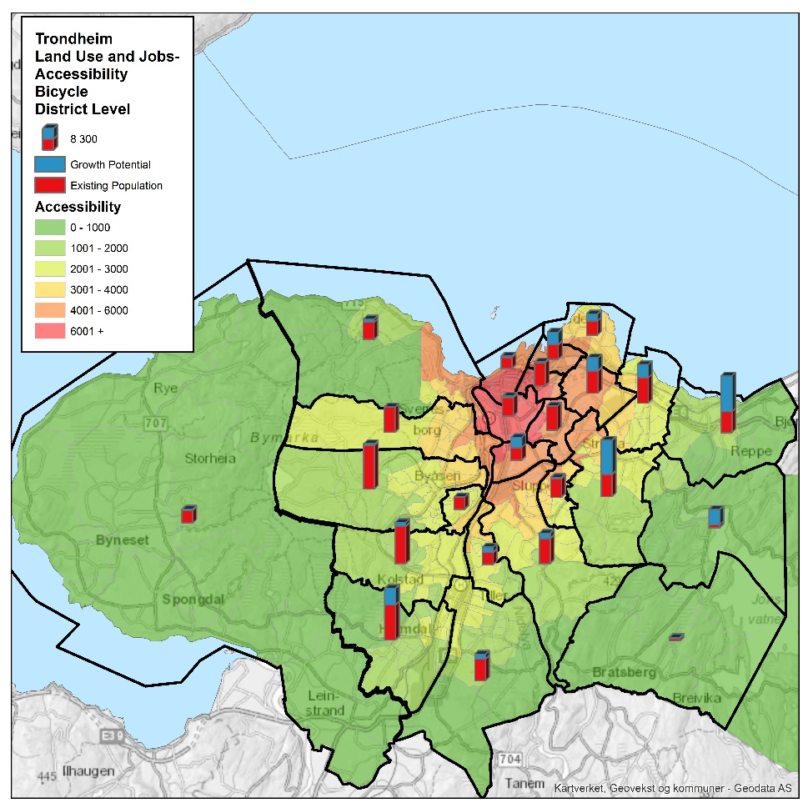
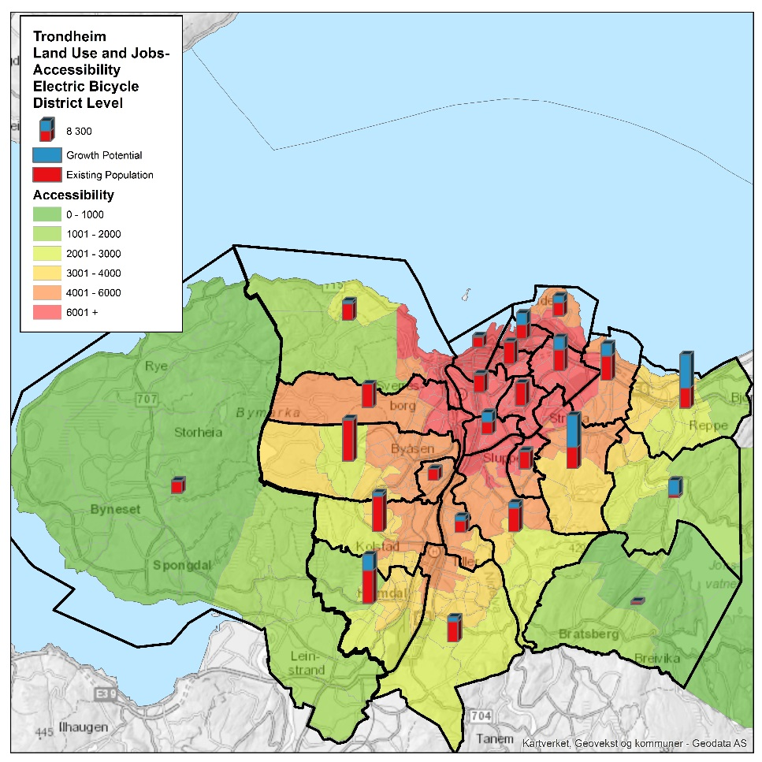
Accessibility_bicycle / E-bike, and
growth potential for Trondheim

Slide 18
2. A survey of Norwegian planners on mitigaiton, adaptation, and travel behaviour
The survey explored the practices of Norwegian regions and municipalities wrt
Climate adaptation and mitigation in regional to and municipal planning
Daily mobility and travel behaviours in regional and municipal planning
A total of 46 respondents, primarily municipal level-planning
Years of experience working with climate adaptation and/or mitigation in regional and municipal planning (44 respondents)
1-10 years | 14 (32 %)
10-20 years | 17 (39 %)
>20 years | 13 (30 %)
Notes:
Additionally, some strategic planning or handling the processing of zoning plans, a few at the regional or state level
Not a representative number, but gives indications of tendencies
Possible that respondents are primarily those with an expressed interest in the topic

Slide 19
Climate adaptation and mitigation in regional and municipal planning (1)
The role of climate adaptation and mitigation in the planning process (45 responses, scale from 1 to 7)
 | Mitigation | Adaptation
To what extent the current planning processes focus upon mitigation/adaptation | 5,04 | 5,20
To what extent they believe mitigation/adaptation should be given focus | 5,91 | 5,91
The apparent dissonance mirrors previous findings regarding climate adaptation (e.g. NIBR, 2017)
The survey results indicate that climate action remains relatively sector based within Norwegian planning
«Har avsatt flomsoner langs hovedvassdrag og innført laveste byggekote mht stormflo langs sjø.»
«Gjenåpning av bekker og elver.»
«Vi setter cote C+3 som laveste høyde for oppholdsrom i bygg. Dette for å sikre mot havstigning.»
Adaptation and mitigation measures taken when planning for future climate changes (20 responses)
 | Number of comments (26 responses, several mentioned multiple topics)
Floods and urban runoff | 9
Land use planning, densification | 3
Transportation and mobility planning (here majority of answers related to public transport) | 5
Have climate plans, use the UN Sustainability Development Goals, etc. | 6
Rising sea levels | 6
Notes:
Adaptive measures such as water management as a result of climate change stands out, a topic that has gained much attention in Norwegian context the latter years after several major events. Mirrors an apparent 'catastrophy'-focus in Norwegian climate adaptation action (NIBR report), and in other international contexts.
Land use and densification, and transport planning are more long term measures, and can be both mitigating and adaptive. Perhaps seen as less related directly to climate action as also related to liveable and attractive places, and a fundamental part of the task of planners/planning.
Together with other questions within this topic, the results/findings indicate that climate action remains to (a relatively large extent?) sector based - meaning it focuses on particular 'themes' rather than a more holistic, overarching approach - looking at the municipality and its challenges as a whole; building upon synergies, etc.

Slide 20
Climate adaptation and mitigation in regional and municipal planning (2)
Wish among respondents for stronger directives/regulations, in part seen as a tool to strengthen work on adaptation and mitigation in municipal planning
Regulations and stronger directives - a more holistic take on mitigaiton and adaptation in planning
«Det vil sannsynligvis understøtte det klimaarbeidet vi allerede gjør.»
«Prioritering av tema setter sterkere fokus i planarbeidet.»
«Vil anta at deler av retningslinjene blir ganske sterkt bindande»
Planned changes in state directives for climate and energy planning (Statlige planretningslinjer for klima- og energiplanlegging)
A) Do you know about the changes? | Ja | 19
 | Nei | 26
B) Do you think this it will lead to bigger changes in the way you/your organisation work with climate adaptation and mitigaiton? | Ja | 4
 | Nei | 16
 | Vet ikke | 21
C) Do you think this can contribute positively to strengthening the work on climate adaptation and mitigaiton? | Ja | 17
 | Nei | 2
 | Vet ikke | 16
Notes:
To some extent knowledge, but the majority wished for more knowledge - both in general and on particular topics. Also reported that could be hard to know what they lacked, and/or if their knowledge was good enough - the complexity of the topic spurring much uncertainty about own - and others' - knowledge. This includes knowing what kind of scientific knowledge is 'correct'.
As we have seen in other projects, the municipalities do not always find the academic knowledge relevant or do not know how to use it. What they often want is local knowledge and statistics that can say something about changes that happen over time, so they can relate it their own situation (source – gåing +AUD???).
Moreover, know that a planners' knowledge is often highly dependent on/related to the planners experience - a challenge then for ensuring the necessary level of competence, as seen for integrated transport and land use planning.

Slide 21
Daily mobility and travel behaviours in regional and municipal planning (1)
Several report having walking and cycling strategies despite this not being a requirement in municipal planning
A result from the focus of Vegvesenet on this?
Influenced by Bypakker/Byvekstavtaler?
An effect of the zero-growth objective (Nullvekstmålet)?
Could these tendencies be strengthened by an obligatory inclusion of mobility plans in municipal planning?
E.g. the implementation of Sustainable Urban Mobility Plans (SUMP)?
How daily mobility is included in planning documents
 | Number of comments per topic (28 in total, several mentioned multiple topics)
Cycling strategy | 16
Walking strategy | 15
Public transport strategy/priorities/initiatives | 9
Urban development, land use that promotes walking, cycling, and public transport use | 5
Mobility plans and analyses | 3
Nodal development (public transport) | 2
«Kortere reiser med gange og sykkel, nettverk for gangforbindelser, sykkelnettverk.»
«Mål om nullvekst legges til grunn, grønn mobilitet innført som begrep.»
«Tilrettelegge for sykkelparkering og lading for sykkel og bil. Gangavstand til kollektivstopp for buss eller bane.»
«Mobilitetsanalyser, grad av utnytting kan avhenge av nærhet til kollektivtransportmidler.»
Notes:
The quotes show that there are changes happening, both to the formal changes that has been made regarding parking and accessibility and the use of mobility plans even if they are not a requirement but comes from a local need

Slide 22
Daily mobility and travel behaviours in regional and municipal planning (2)
Potential changes in daily travel behaviours and habits
 | Number of responses
Increase in public transport use | 40
Increase in cycling shares | 38
Increase in use of electrical cars | 27
Changes in car use | 25
Increase in use of electrical bikes | 24
Increase in car sharing | 17
Introduction of autonomous cars | 6
In a follow up question, respondents said they estimate only a slight reduction in car use
“Vi vet ikke hvordan reisevanene vil endre seg, men vi planlegger for å endre de. Svært mange overordnede dokumenter legger opp til at vi planlegger for endring, spesielt mer gange, sykkel og kollektiv.»
Other sources for ‘estimating’ future travel behaviours
Analyses, reports, investigations, travel surveys, etc., by the municipality or external actors
The objectives and plans of the municipality
Sources to plan for future travel behaviours
 | Number of responses
National travel surveys | 31
Local conditions | 29
Experience-based local knowledge | 27
Trends | 24
International studies | 10
Other | 12
Table 7: Potential changes in daily travel behaviours and habits
Notes:
The quotes show that there are changes happening, both to the formal changes that has been made regarding parking and accessibility and the use of mobility plans even if they are not a requirement but comes from a local need

Slide 23
Comments to survey findings and results
The survey results indicates that planning for adaptation and mitigation follows national rules and expectations
Moreover, that rules and guidelines are important for the planners
They set the agenda for what is included in plans – particularly for adaptation and mitigation
Could regulations and stronger directives lead towards a more holistic take on mitigaiton and adaptation in planning?
Well established sectors like physical planning and transport are seemingly still treated as separate from climate change, both on government and local levels
Will the planned changes in state directives (as presented) lead to a change for this?
Is there room for a positive approach to climate change, seeing it as opportunities?
Notes:
To some extent knowledge, but the majority wished for more knowledge - both in general and on particular topics. Also reported that could be hard to know what they lacked, and/or if their knowledge was good enough - the complexity of the topic spurring much uncertainty about own - and others' - knowledge. This includes knowing what kind of scientific knowledge is 'correct'.
As we have seen in other projects, the municipalities do not always find the academic knowledge relevant or do not know how to use it. What they often want is local knowledge and statistics that can say something about changes that happen over time, so they can relate it their own situation (source – gåing +AUD???).
Moreover, know that a planners' knowledge is often highly dependent on/related to the planners experience - a challenge then for ensuring the necessary level of competence, as seen for integrated transport and land use planning.

Slide 24
In conclusion
Need for periodic checks: MET, Travel Behaviour Analyses, Directives/regulations
Bring together multiple scenario-building exercises
Build focus on changing travel behaviour and attitudes
Redo the project in 2050.

Slide 25
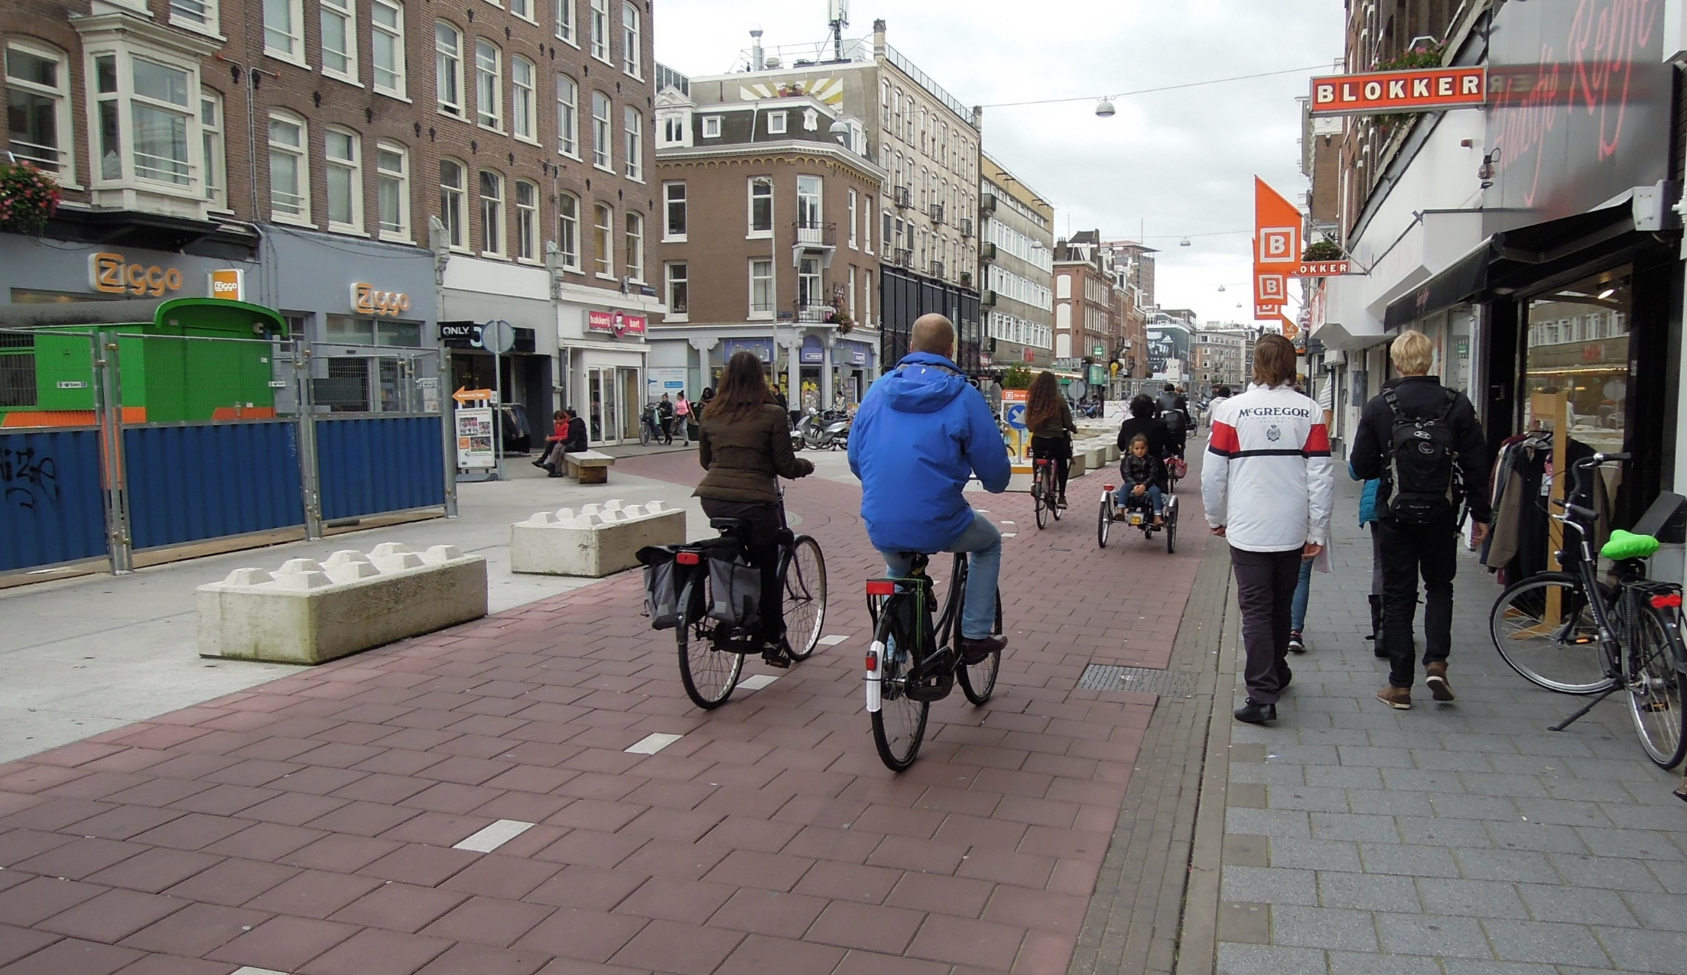
TAKK FOR OPPMERKSOMHETEN!
tpu@toi.no
mkr@toi.no

